Slide 1
Self-Serve Transformation
Sep 1, 2016
PTE10785 2/16

Slide 2
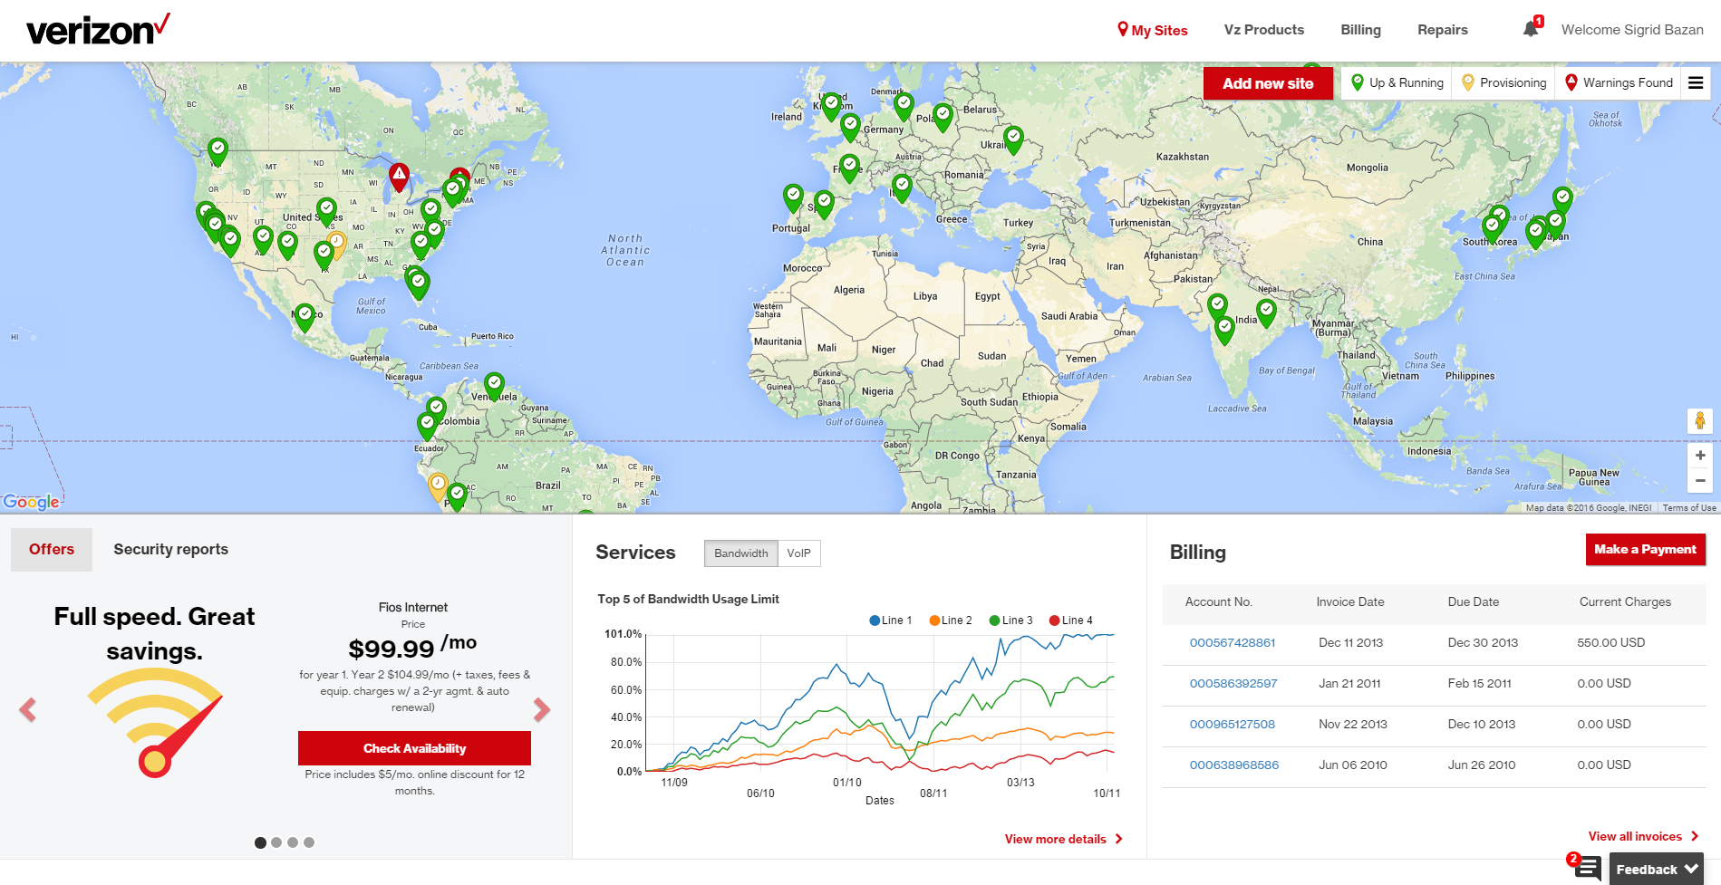
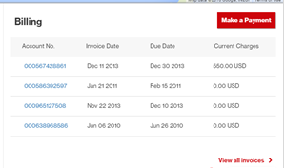
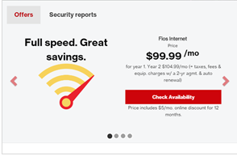
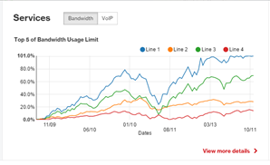
Self-Service Transformation: Customer Centric View
Widget based – device agnostic UI development
Bus Layer, to aggregate API information for UI (widget) consumption
Business Services layer – API Aggregation
Robust API platform to expose all types of services to the front ends
API Platform (to expose APIs)
Discovery | Security
Translation | Metrics
Creation of, and use of new/existing services across IT applications
Cloud | MQ | JMS
Web Services Microservices | Web Services Microservices | Web Services Microservices
Back office systems
Notes:
I will talk through how the new UI being designed is playing out. (We want to move away from just stating Prod Simplification. Now it is more like Self-Service Transformation.) Hence the heading..
Dave/Richard: You might want to pitch in and talk about the iterations with the customers and the interactions you are having with the dev team in building out newer models. Thanks!

Slide 3
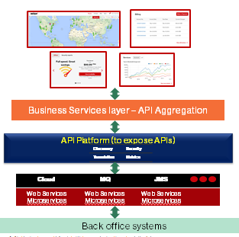
SDLC in this new ecosystem?
People | Process | Technology
Customer experience innovators | Stitch various UI widgets together to create a seamless customer experience | ‘Application’ level infrastructure where the UI widgets will coexist
CX/UX experts | Define process around how widgets are created. The templates, standards that need to be used | Bootstrap, VZBootstrap, Current UX libraries, etc
‘Application’/UI Widget SMEs | Build, collate the functionality depicted by the UI Widget in question by aggregating APIs exposed by the API Platform | Business rules, application layer based technologies
API Platform experts | Build, maintain, sustain the various different APIs that need to be exposed on the platform. Run analytics, uphold security, etc | APIGEE, WS02, etc
Microservices and Web services developers | Build granular, low level services that provide a clear, atomic service that is useful | Web services, REST APIs, SOAP services, etc
Applications

Slide 4
Appendix

Slide 5
Self-Service Transformation: Customer Centric View
Widget based – device agnostic UI development
Robust API platform to expose all types of services to the front ends
APIGEE based API Platform (to expose APIs)
Translation
Security
Metrics
Creation of, and use of new/existing services across IT applications
Micro-services
Micro-services
Web Services
Cloud based services
MQ services
JMS services
Back office systems
Notes:
I will talk through how the new UI being designed is playing out. (We want to move away from just stating Prod Simplification. Now it is more like Self-Service Transformation.) Hence the heading..
Dave/Richard: You might want to pitch in and talk about the iterations with the customers and the interactions you are having with the dev team in building out newer models. Thanks!

